Slide 1
Classical Encryption Techniques Md. Alamgir Hossain Senior Lecturer, Dept. of CSE, Prime University alamgir.cse14.just@gmail.com

Slide 2

Classical Cryptography
Classical cryptography is based on mathematics, and it relies on the computational difficulty of factorizing large numbers.
The security of classical cryptography is based on the high complexity of the mathematical problem for the instance factorization of large number.
Classical Cryptography has two types of techniques: Symmetric Cryptography, Asymmetric Cryptography

Slide 3
Symmetric Cryptography
In symmetric cryptography, a single key is used for encrypting and decryption the data.
This encryption key is the private key.
This is the limitation of this encryption technology that this private key must be distributed only among the authorized sender and receiver.

Slide 4
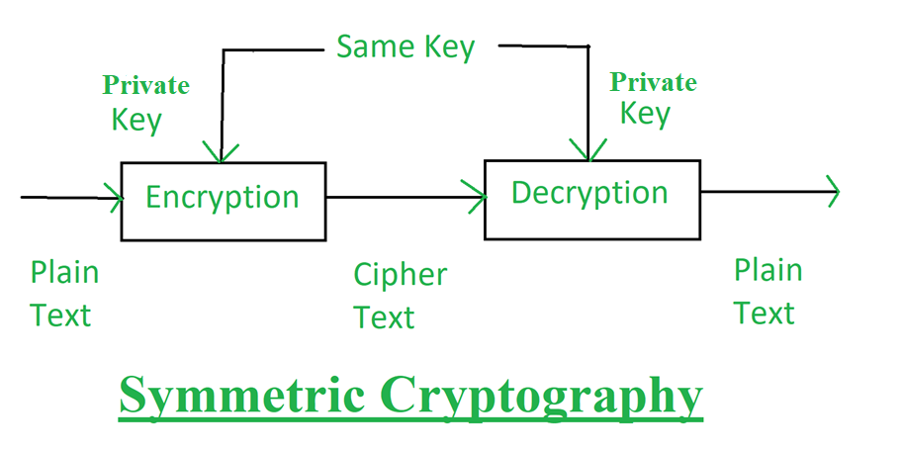
Symmetric Cryptography

Slide 5
Asymmetric Cryptography
In asymmetric cryptography, a pair of key, i.e., public key and the private key is used for encryption and decryption.
A sender can use its public key to encrypt the data, and on the receiver, the end receiver can decrypt the data by using its private key.
This technique overcomes the problem of key distribution.

Slide 6
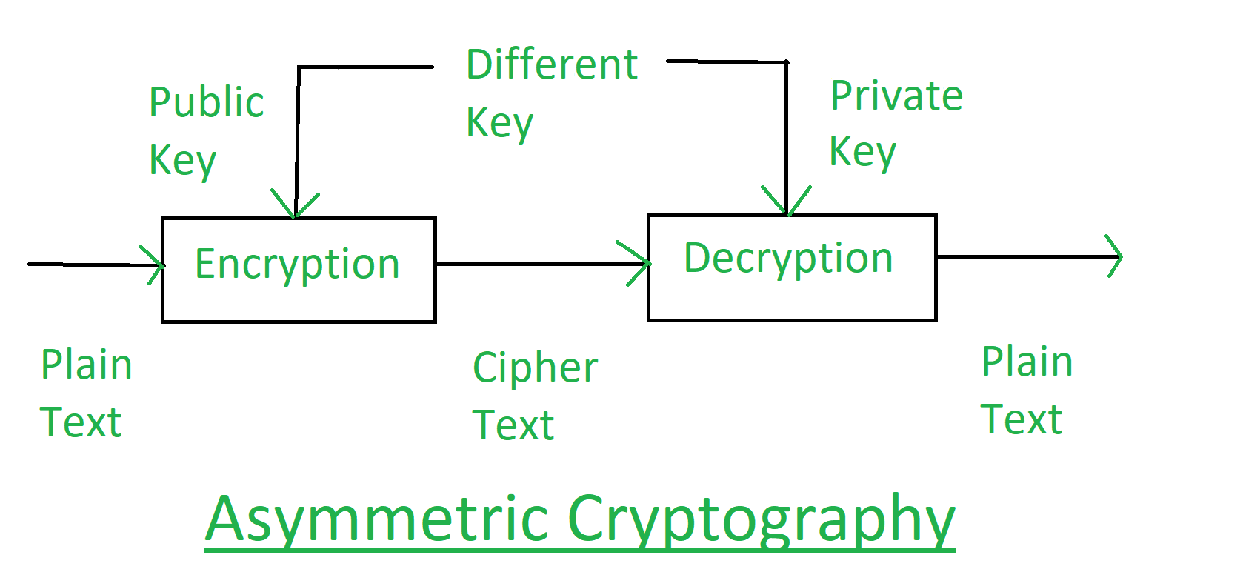
Asymmetric Cryptography

Slide 7
Some Basic Terminology
Plaintext - original message
Ciphertext - coded message/encrypted message
Cipher - algorithm for transforming plaintext to ciphertext
Key - info used in cipher known only to sender/receiver
Encipher (encrypt) - converting plaintext to ciphertext
Decipher (decrypt) - recovering ciphertext from plaintext
Cryptography - study of encryption principles/methods
Cryptanalysis (codebreaking) - study of principles/ methods of deciphering ciphertext without knowing key

Slide 8
Elements of Symmetric Encryption
Plaintext: This is the original intelligible message or data that is fed into the algorithm as input.
Encryption algorithm: The encryption algorithm performs various substitutions and transformations on the plaintext.
Secret key: The secret key is also input to the encryption algorithm. The key is a value independent of the plaintext and of the algorithm. The algorithm will produce a different output depending on the specific key being used at the time. The exact substitutions and transformations performed by the algorithm depend on the key.
Ciphertext: This is the scrambled message produced as output. It depends on the plaintext and the secret key. For a given message, two different keys will produce two different ciphertexts. The ciphertext is an apparently random stream of data and, as it stands, is unintelligible.
Decryption algorithm: This is essentially the encryption algorithm

Slide 9
Requirements for Secure use of Symmetric Encryption
A strong encryption algorithm: The opponent should be unable to decrypt ciphertext or discover the key even if he/she is in possession of a number of ciphertext together with the plaintext.
A secret key is known only to sender/receiver.
We assume that it is impractical to decrypt a message on the basis of the ciphertext plus knowledge of the encryption/decryption algorithm.
Algorithms are known or widely available, but the principal security problem is maintaining the secret key.

Slide 10
Cryptographic System
Can characterize cryptographic system by:
Type of encryption operations used
substitution
transposition
product
Number of keys used
single-key or private
two-key or public
Way in which plaintext is processed
block
stream

Slide 11
Classical Encryption Techniques

Slide 12
Substitution Techniques
A substitution technique is one in which the letters of plaintext are replaced by other letters or by numbers or symbols.
If the plaintext is viewed as a sequence of bits, then substitution involves replacing plaintext bit patterns with ciphertext bit patterns.

Slide 13

Substitution Techniques(Caesar Cipher)
The earliest known use of a substitution cipher, and the simplest, was by Julius Caesar. The Caesar cipher involves replacing each letter of the alphabet with the letter standing three places further down the alphabet.
For example,
plain: meet me after the toga party
cipher: PHHW PH DIWHU WKH WRJD SDUWB
Note that the alphabet is wrapped around, so that the letter following Z is A. We can define the transformation by listing all possibilities, as follows:
plain: a b c d e f g h i j k l m n o p q r s t u v w x y z
cipher: D E F G H I J K L M N O P Q R S T U V W X Y Z A B C

Slide 14
Substitution Techniques(Caesar Cipher)
Mathematically give each letter a number:
a b c d e f g h i j k l m n o p q r s t u v w x y z
0 1 2 3 4 5 6 7 8 9 10 11 12 13 14 15 16 17 18 19 20 21 22 23 24 25
Then the algorithm can be expressed as follows. For each plaintext letter p, substitute the ciphertext letter C, k is the shift key. Then have Caesar cipher as:
c = E(p) = (p + k) mod (26)
p = D(c) = (c – k) mod (26)
plaintext: defend the east wall of the castle
Ciphertext: efgfoe uif fbtu xbmm pg uif dbtumf

Slide 15
Substitution Techniques(Caesar Cipher)
Security Issue:
Caesar Cipher is not a secure cryptosystem because there are only 26 possible keys to try out.
An attacker can carry out an exhaustive key search with available limited computing resources.

Slide 16
Monoalphabetic Cipher
Monoalphabetic cipher is a substitution cipher in which for a given key, the cipher alphabet for each plain alphabet is fixed throughout the encryption process.
For example, if ‘A’ is encrypted as ‘D’, for any number of occurrence in that plaintext, ‘A’ will always get encrypted to ‘D’.
Plain Text: WE ARE THE STUDENTS OF PRIME UNIVERSITY.
Key: PNFXTQCSEYOHLUMRKZAJDWBGIV
Cipher Text: BT PZT JST AJDXTUJA MQ RZELT DUEWTZAEJI.

Slide 17
Thank You

